Slide 1
Diffusion Models for Images & Videos

Slide 2
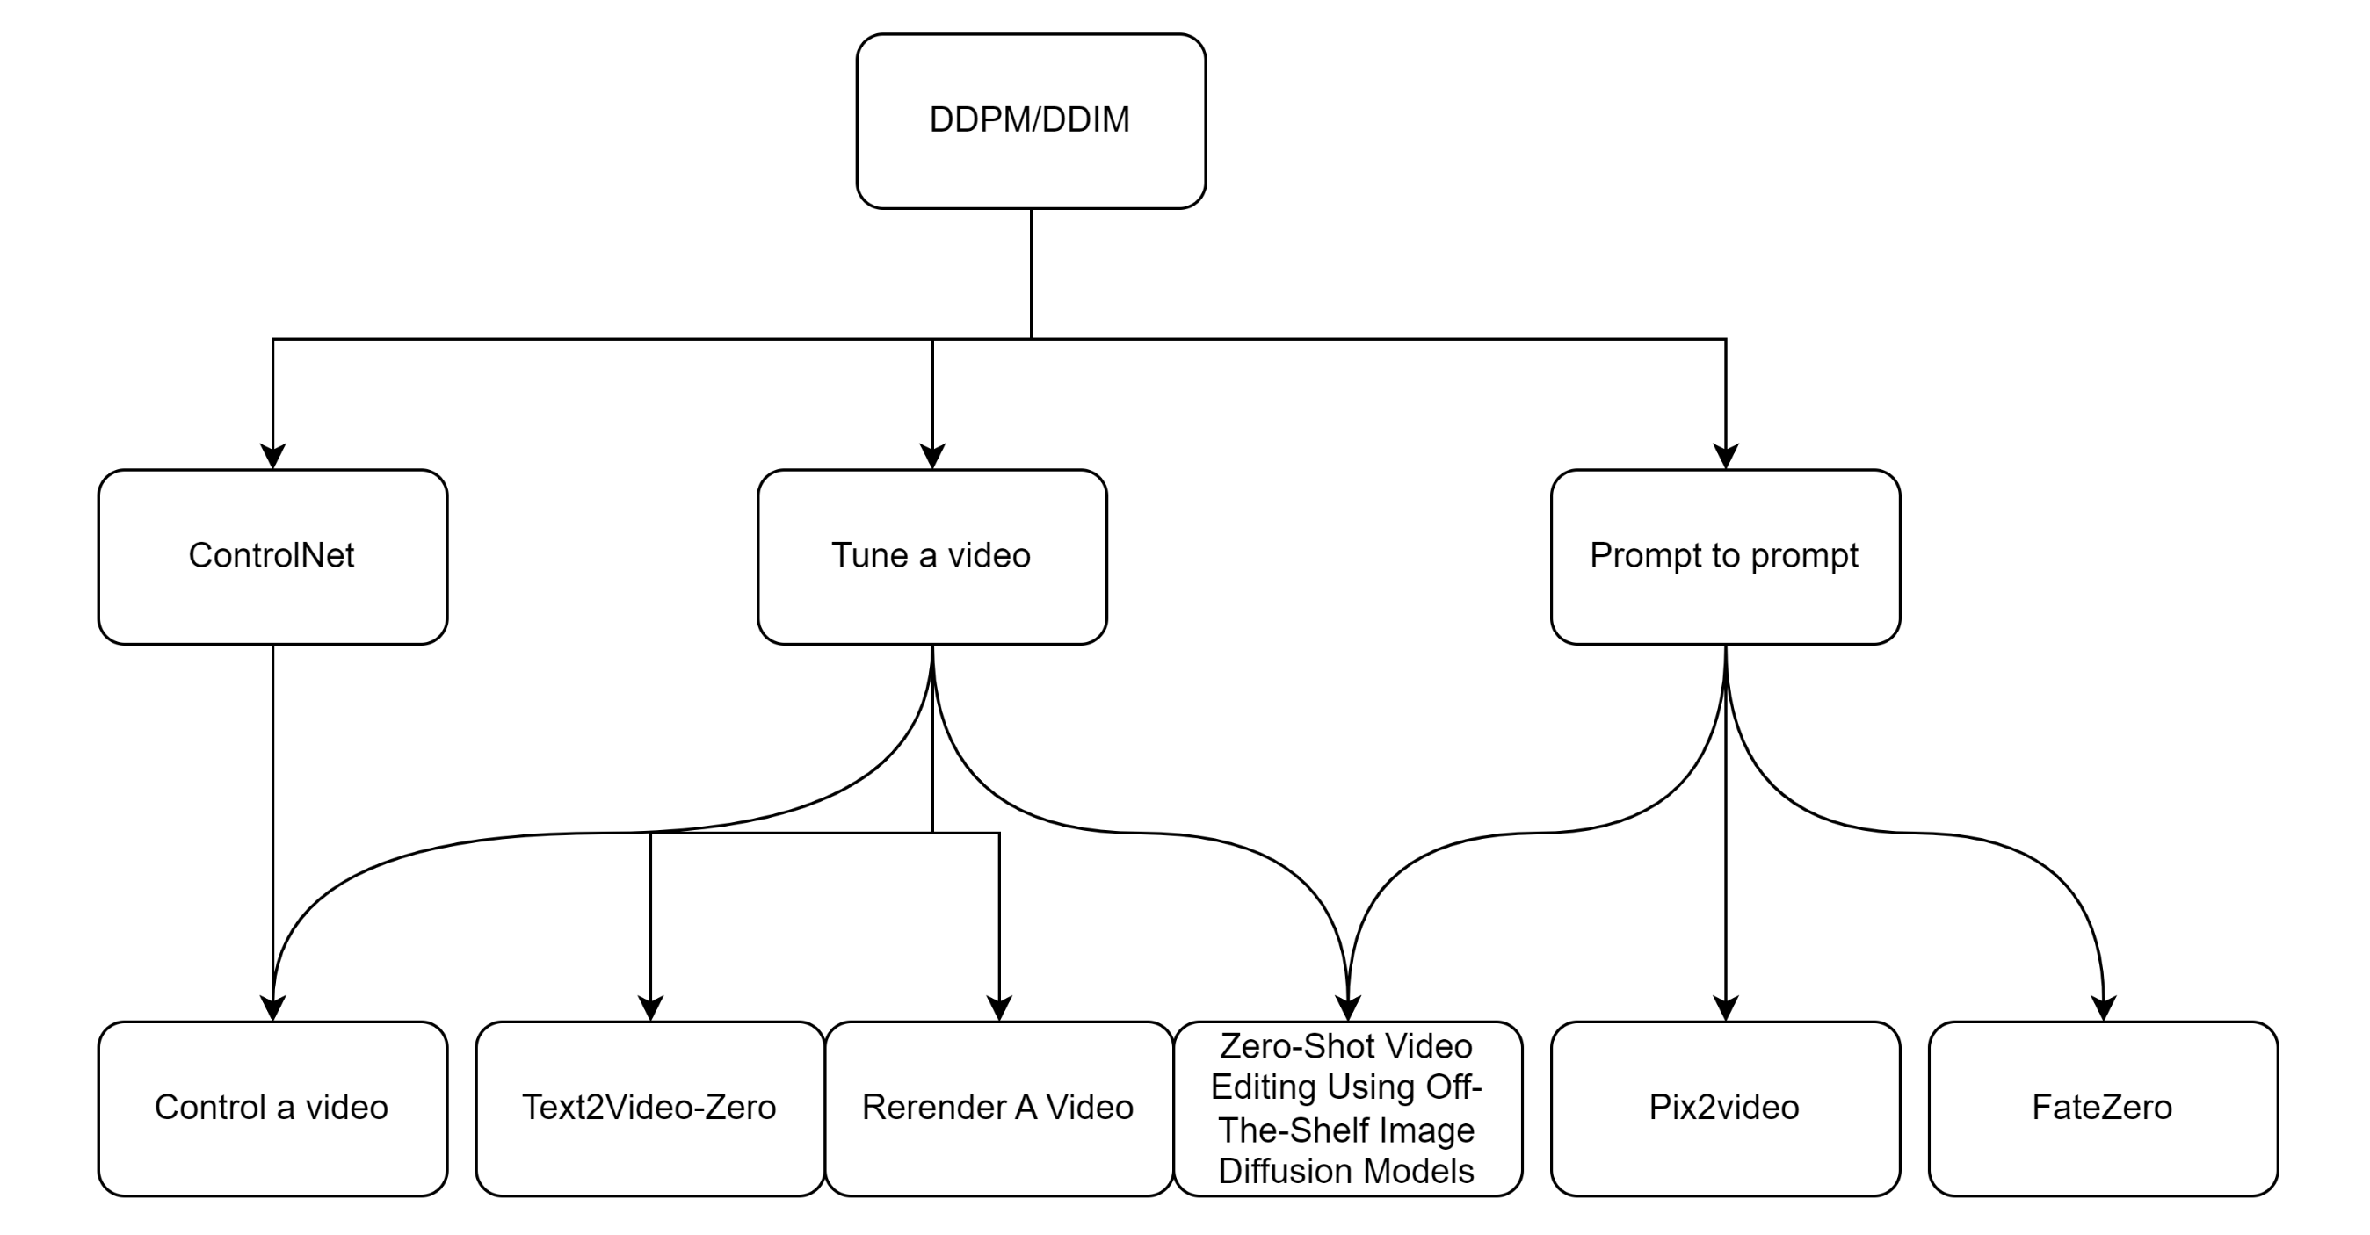

Slide 3
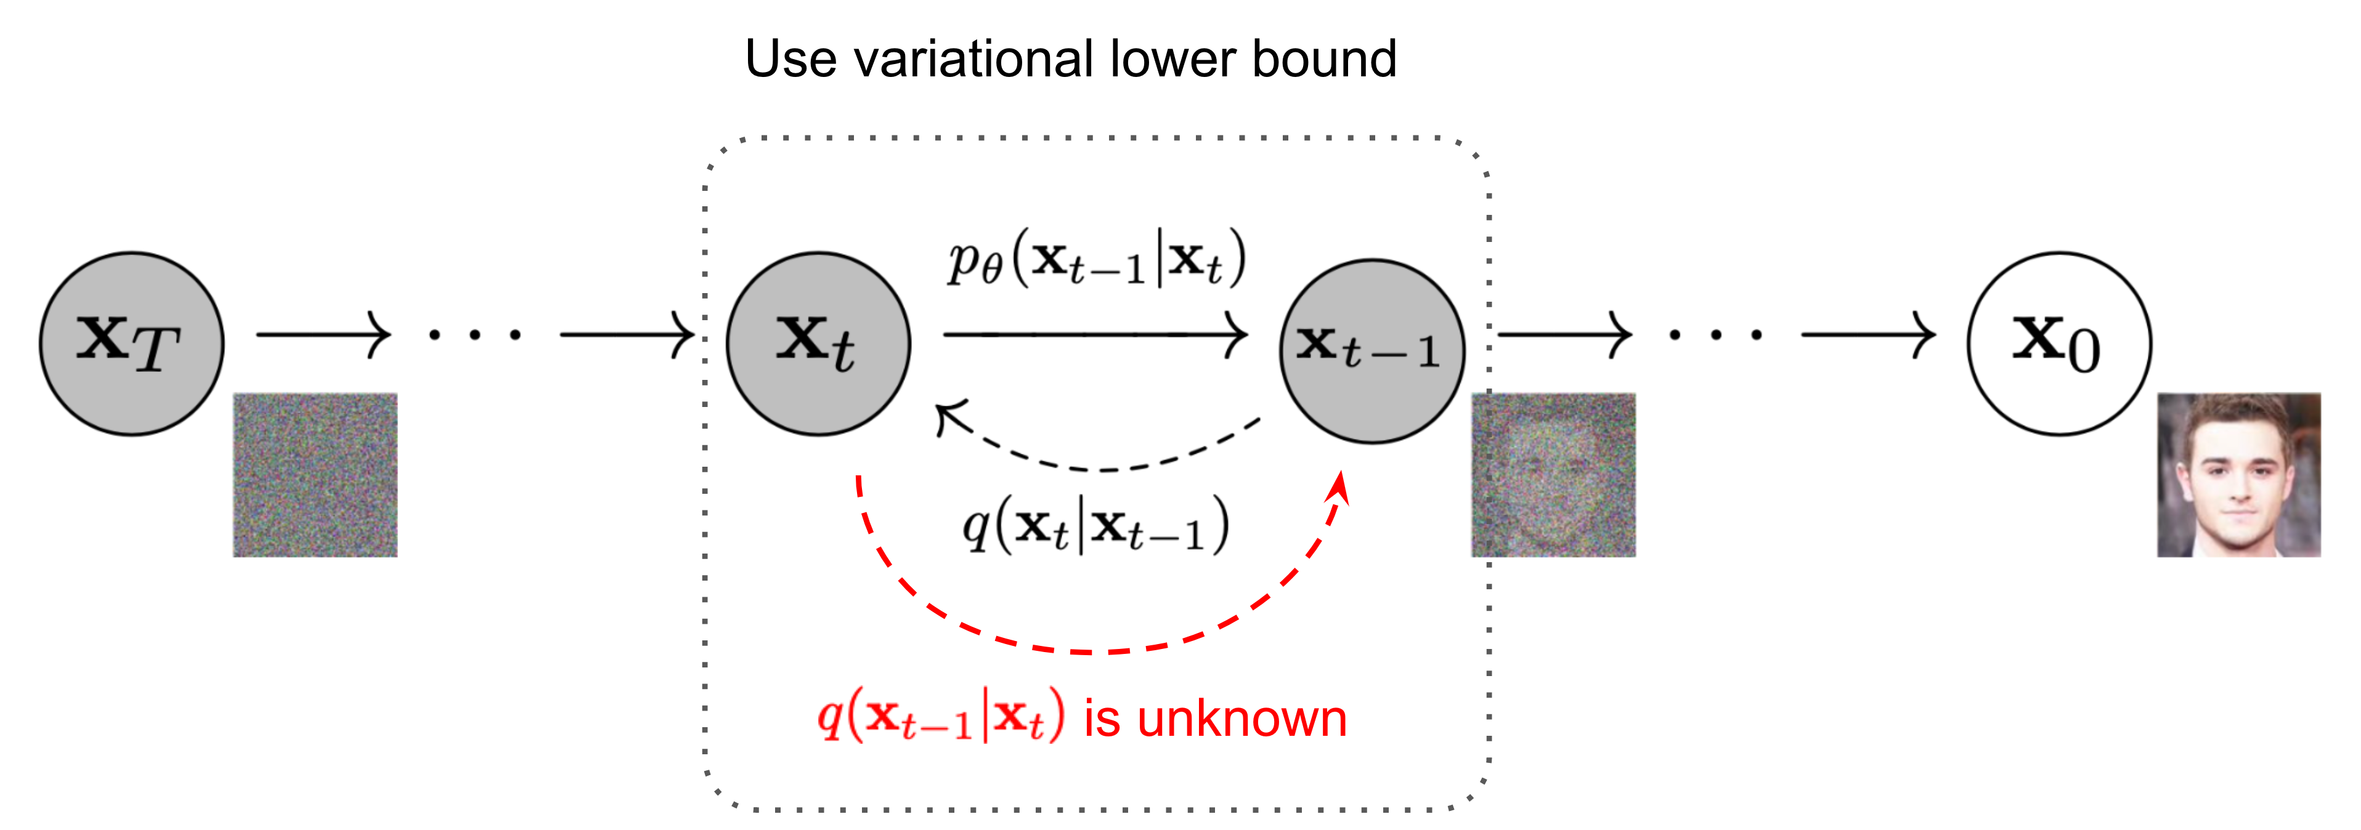
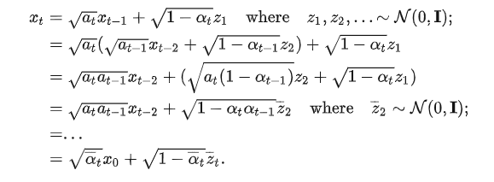
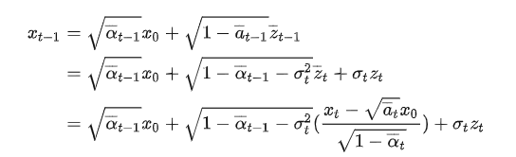
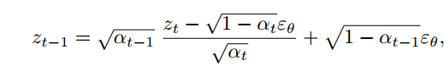
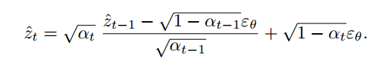
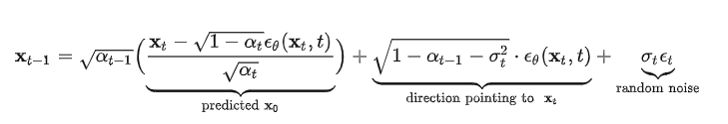
DDPM/DDIM
DDPM:
DDIM:
Sampling:
Inversion:

Slide 4
DDPM/DDIM

Slide 5
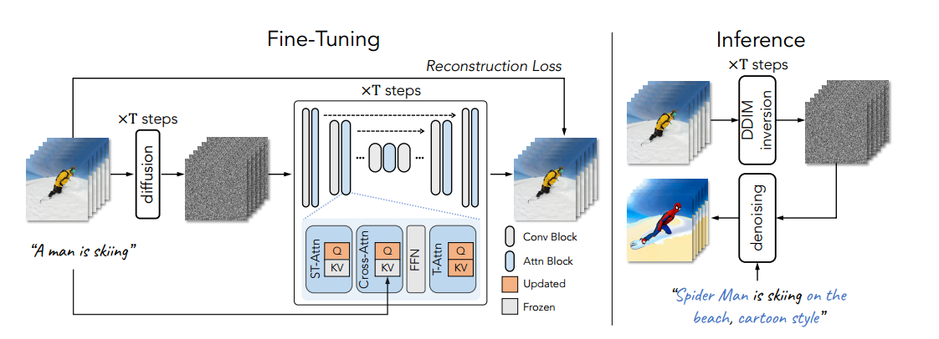
Tune a video

Slide 6
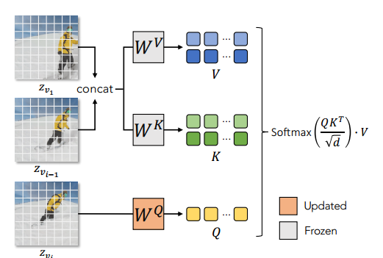
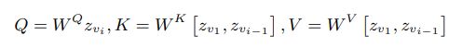
Tune a video
Regarding motion : T2I models are able to generate images that align well with the text, including the verb terms.
Regarding consistent objects : Simply extending the spatial self-attention in the T2I model from one image to multiple images produces consistent content across frames

Slide 7
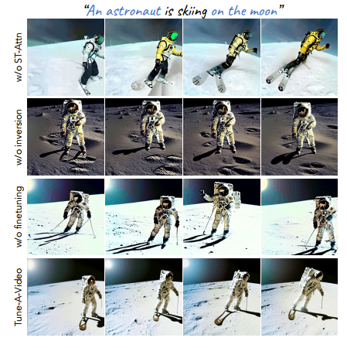
ST-Attn : 维持前后景的一致性
Inversion : 维持输入视频的动作
Finetuning :优化运动的流畅程度
Notes:
消融实验

Slide 8
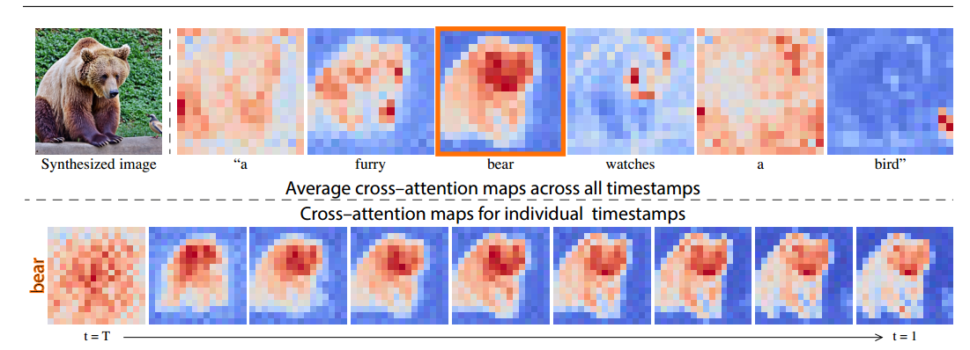
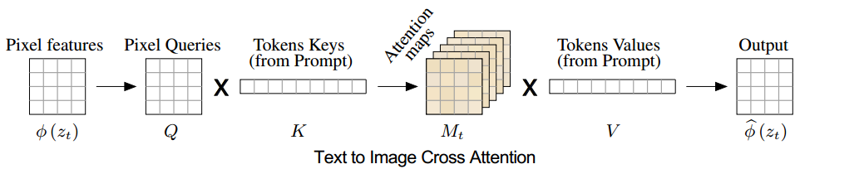
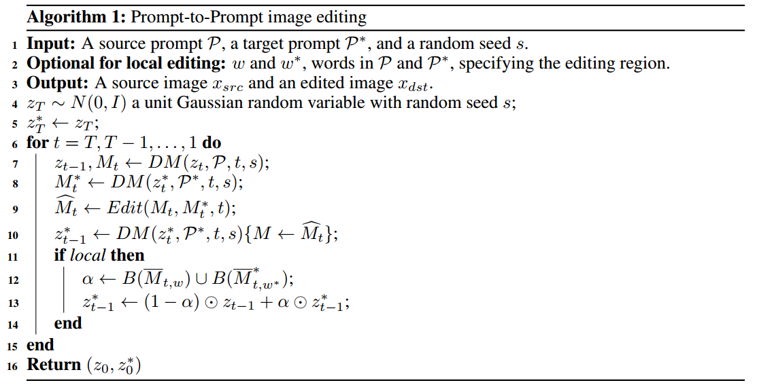
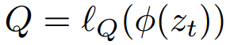
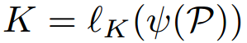
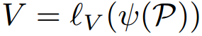
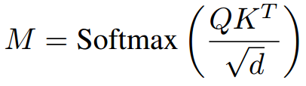
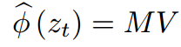
Prompt to prompt

Slide 9
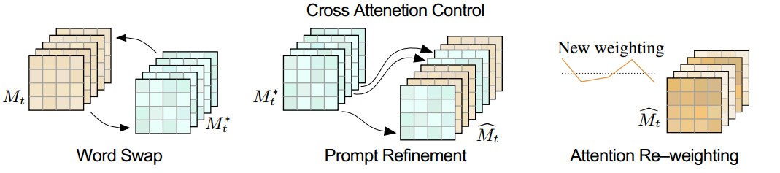
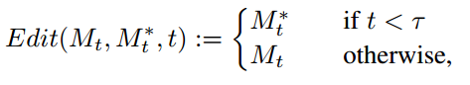
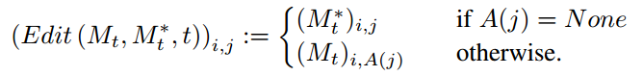
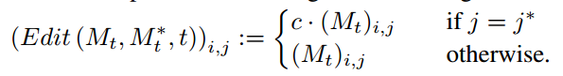
Prompt to prompt
Word Swap
Prompt Refinement
Attention Re-weighting

Slide 10
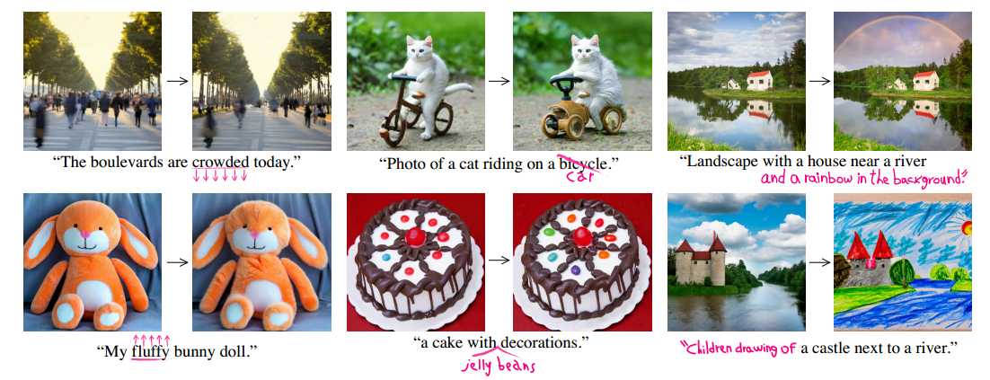
Prompt to prompt

Slide 11
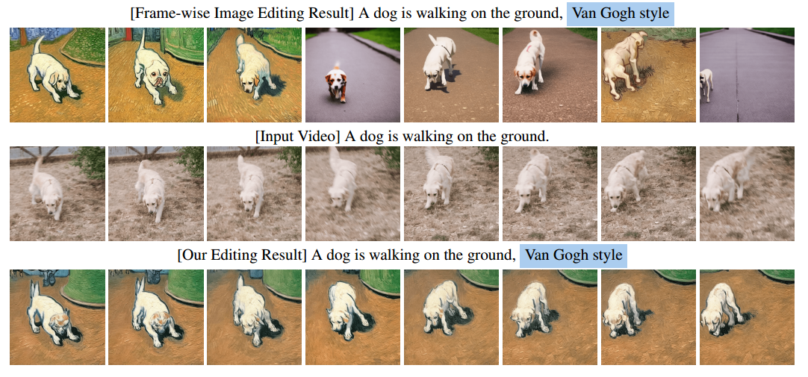
Zero-Shot Video Editing
Comparison
Tune-A-Video：zero shot
Image Editing：temporally-consistent results

Slide 12
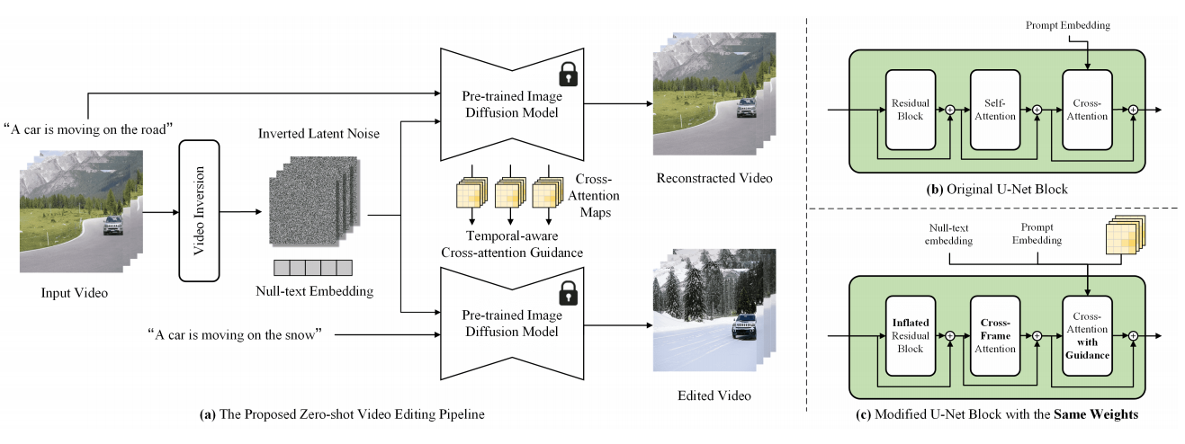
Zero-Shot Video Editing

Slide 13
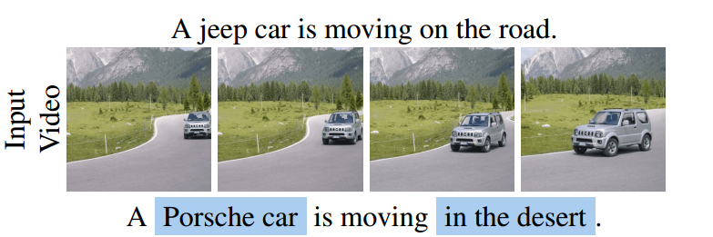
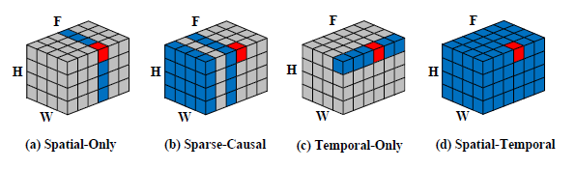
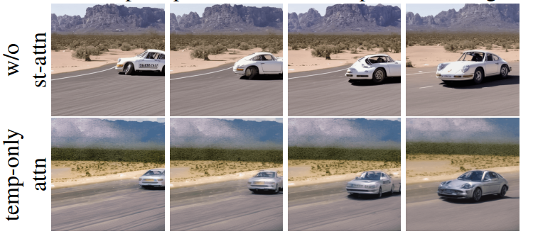
Zero-Shot Video Editing
(b) Tune-A-Video: over-emphasizes the previous frames of the video, and the editing errors in the first few video frames propagate to the subsequent frames
(c) completely abandons spatial modeling, leading to a significant discrepancy with the self-attention in pre-trained image diffusion models
(d) bi-directional temporal modeling

Slide 14
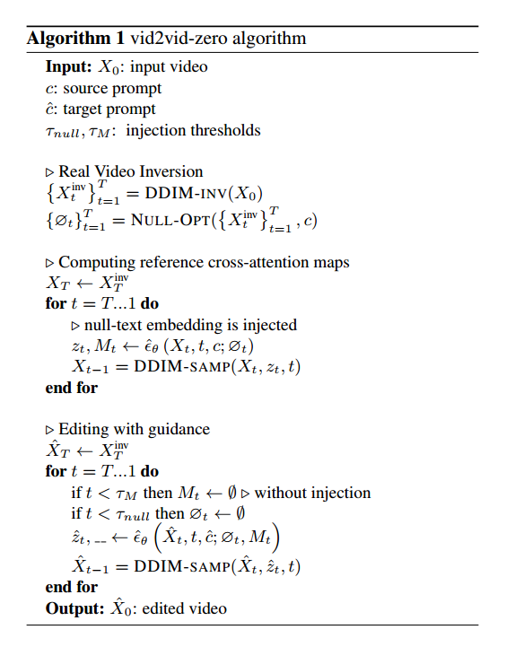
Zero-Shot Video Editing
Null text Optimization
Temporal Modeling
Spatial Regularization

Slide 15
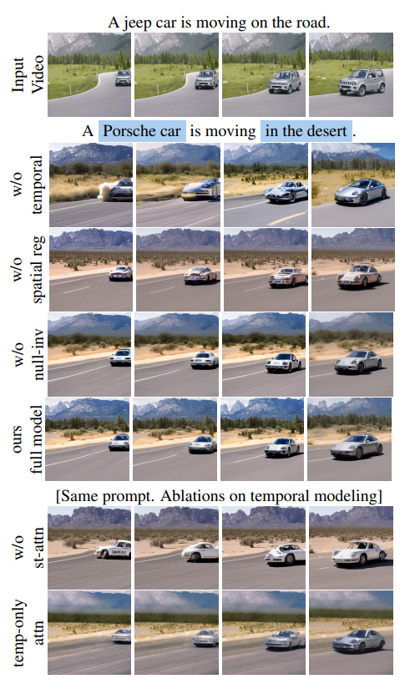
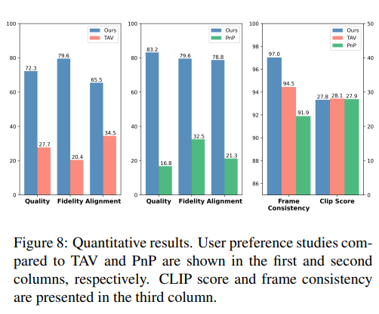
Zero-Shot Video Editing
Experiments
CLIP score: computes the similarity between the target prompt and the edited videos
Frame consistency: cosine feature similarity of consecutive frame pairs, based on their CLIP embedding

Slide 16
Zero-Shot Video Editing

Slide 17
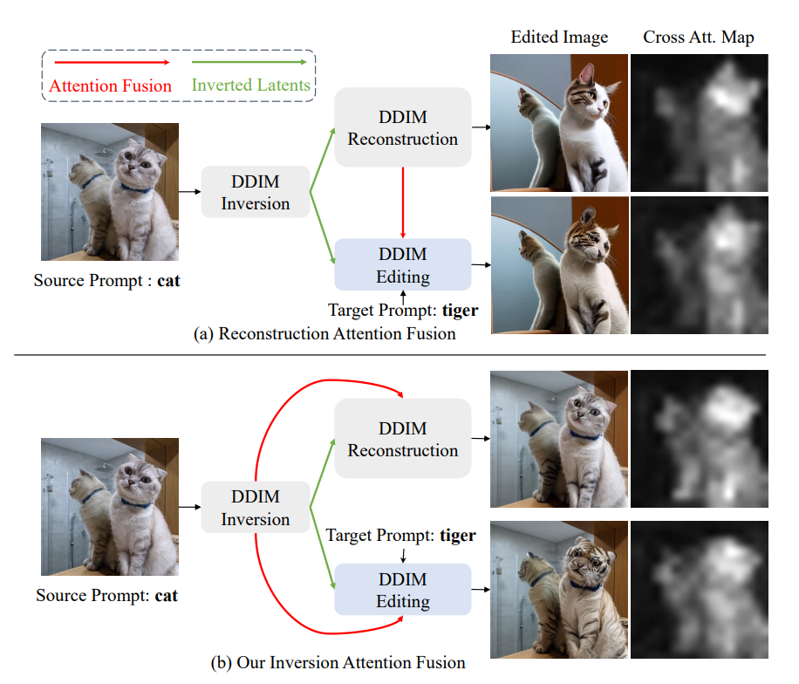
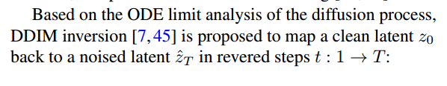
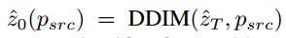
FateZero
DDIM Sampling:
DDIM Inversion:

Slide 18
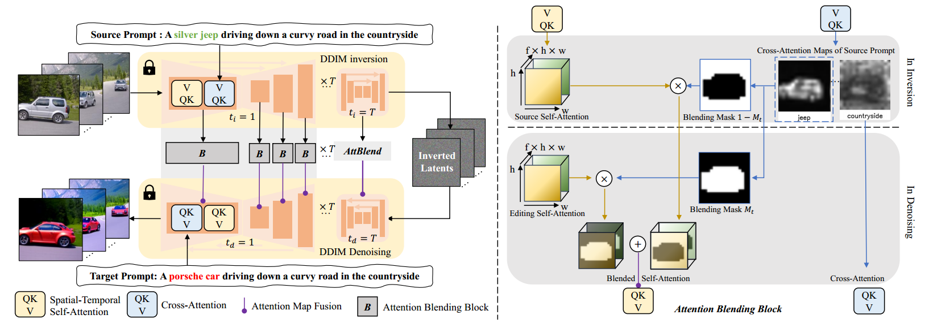
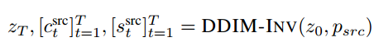
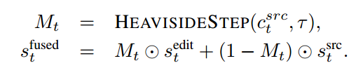
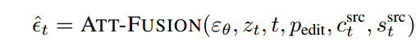
FateZero

Slide 19
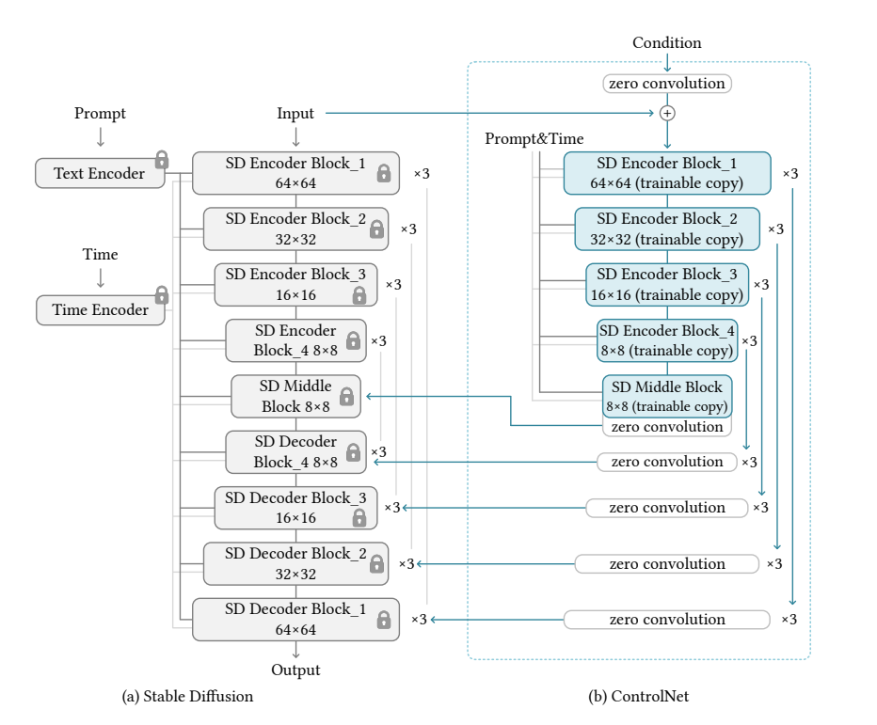
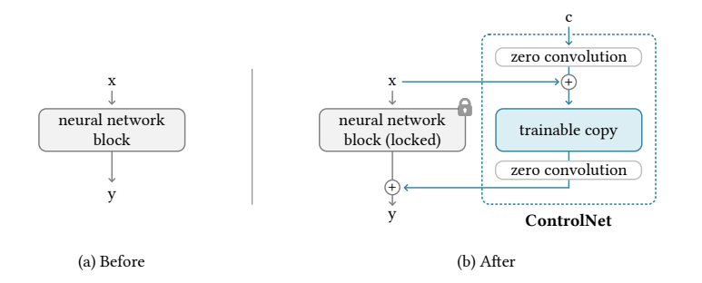
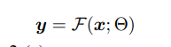
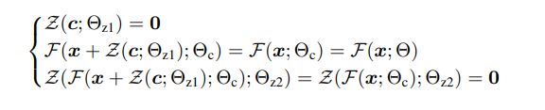
ControlNet
First step

Slide 20
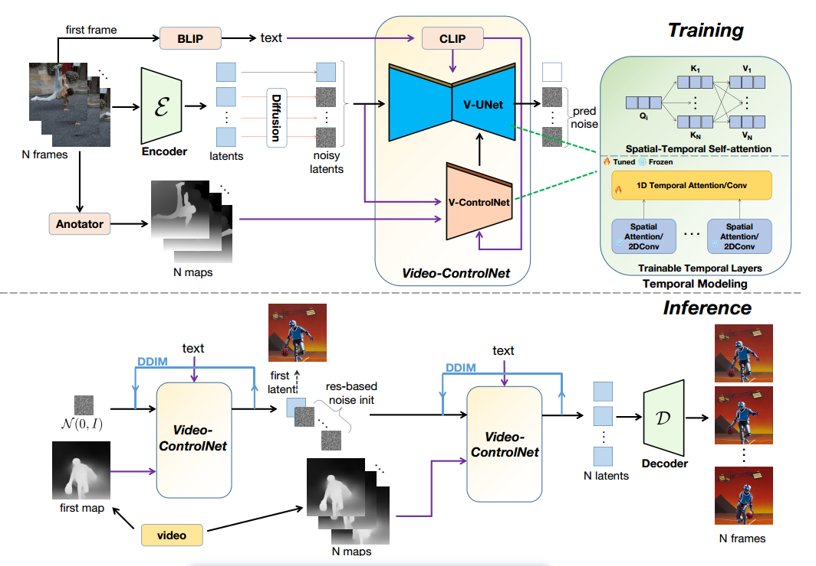
Control a video

Slide 21
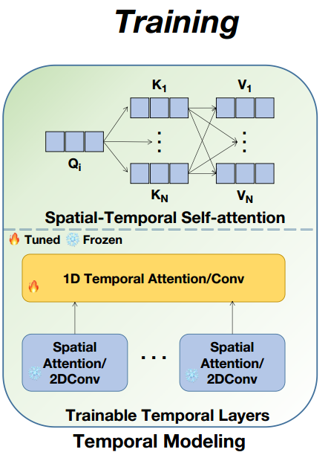
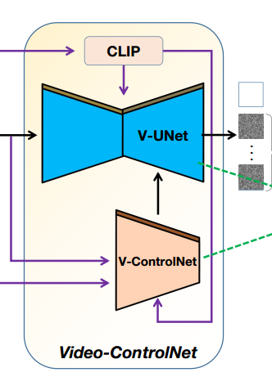
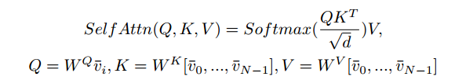
Control a video
an additional temporal layer after each 2-dimensional (2D) layer,including 2D convolution and 2D attention
modify the 2D spatial self-attention layer to incorporate temporal information
V-ControlNet

Slide 22
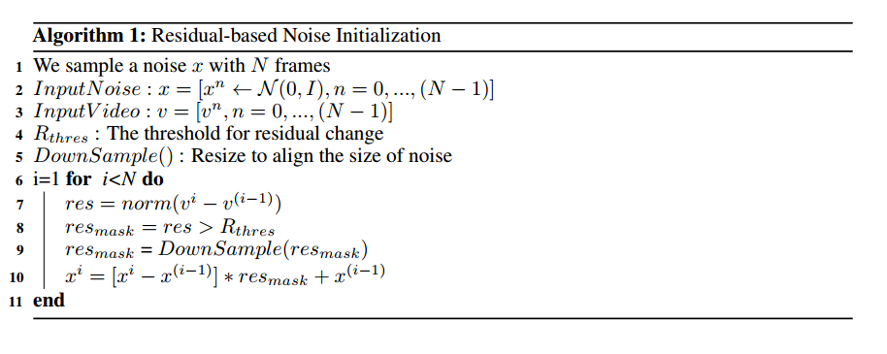
Control a video
Residual-Based Noise Initialization
In video compression, it is typical to store keyframes along with residuals/motion, instead of individual pixels for each frame.
Goal :maintain the same noise in areas where the pixels of the input video remain unchanged between frames and use different noise in areas where the pixels of the input video change between frames.
Notes:
首先，为每一帧随机初始化一个噪声，然后计算相邻帧像素上的差值
静态区域拥有相同的噪声，动态区域是不同的噪声；通过设定阈值来调节平滑度
如果阈值设置为1，则所有帧的噪声都是相同的，这可能会导致伪影。如果阈值设置为零，则每帧的噪声都是独立采样的，这可能会导致闪烁。

Slide 23
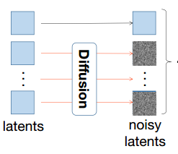
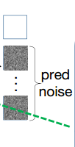



Control a video
Training & Inference
proposed a first-frame conditioning method
generates video sequences conditioned on the first frame
reduces the need for the model to memorize video content in the training set
focuses on learning to reconstruct motion
achieve better results with a smaller video dataset
Generate first frame:
Generate following frame:

Slide 24


Control a video
Experiments
Backbone: Stable Diffusion v1.5;
ControlNet
Dataset: 100k video clips
& 100k image-text pairs

Slide 25

Control a video
Ablation Study
distinct noise (threshold=0.0):background flickers
identical noise (threshold=1.0) : a smooth video, but with severe artifacts

Slide 26

Text2video-zero

Slide 27


Text2video-zero

Slide 28



Text2video-zero

Slide 29

Text2video-zero
better text-video alignment
Experiments
CogVideo

Slide 30

Text2video-zero
Experiments

Slide 31

Text2video-zero
Ablation Study

Slide 32
Text2video-zero

Slide 33



Pixel2video
DDIM Inversion
Self-attention Feature Injection
Guided Latent Update

Slide 34



Pixel2video
Guided Latent Update（ only for first 25 steps ）
${\hat{x}}_{0}^{t}是一个$关于$x_{t}$的式子，表示第t步时对$x_{0}$的预测

Slide 35




Pixel2video
Comparison
User Study
Quantitative comparison
Notes:
does not require a heavy pre-processing stage nor a per-video or per-edit finetuning strategy.

Slide 36

Pixel2video
Ablation Study
a fixed anchor frame: structural artifacts as the distance between the anchor and the edited frame increases
the previous frame only: temporal and structural artifacts
an anchor frame and a randomly selected previous frame: temporal and structural artifacts
an anchor frame and a previous frame
previous frame: represents the state of the edit in a recurrent manner
anchor frame: temporal consistency

Slide 37
Pixel2video

Slide 38

Rerender a video
Style-aware cross-frame attention
Shape-aware cross-frame latent fusion
Pixel-aware cross-frame latent fusion
Color-aware adaptive latent adjustment

Slide 39


Rerender a video
Style-aware cross-frame attention
Shape-aware cross-frame latent fusion

Slide 40




Rerender a video
Pixel-aware cross-frame latent fusion
Structure-guided inpainting
Fidelity-oriented image encoding

Slide 41



Rerender a video
Comparison

Slide 42

https://anonymous-31415926.github.io/

Slide 43

Rerender a video
Ablation Study

Slide 46
Rerender a video
Color-aware adaptive latent adjustment
在靠后的时间步，使用AdaIN匹配第一帧和第i帧的${\hat{x}}_{t}$
Full Video Translation
Color-aware adaptive latent adjustment
Full Video Translation
Patch-based propagation
Temporal-aware blending
（TODO）
Notes:
y AdaIN [15] to xˆit→0to match its channel wise mean and variance to xˆ1t→0in the late steps. It can further keep the color style coherent throughout the whole key frames

